Slide 1
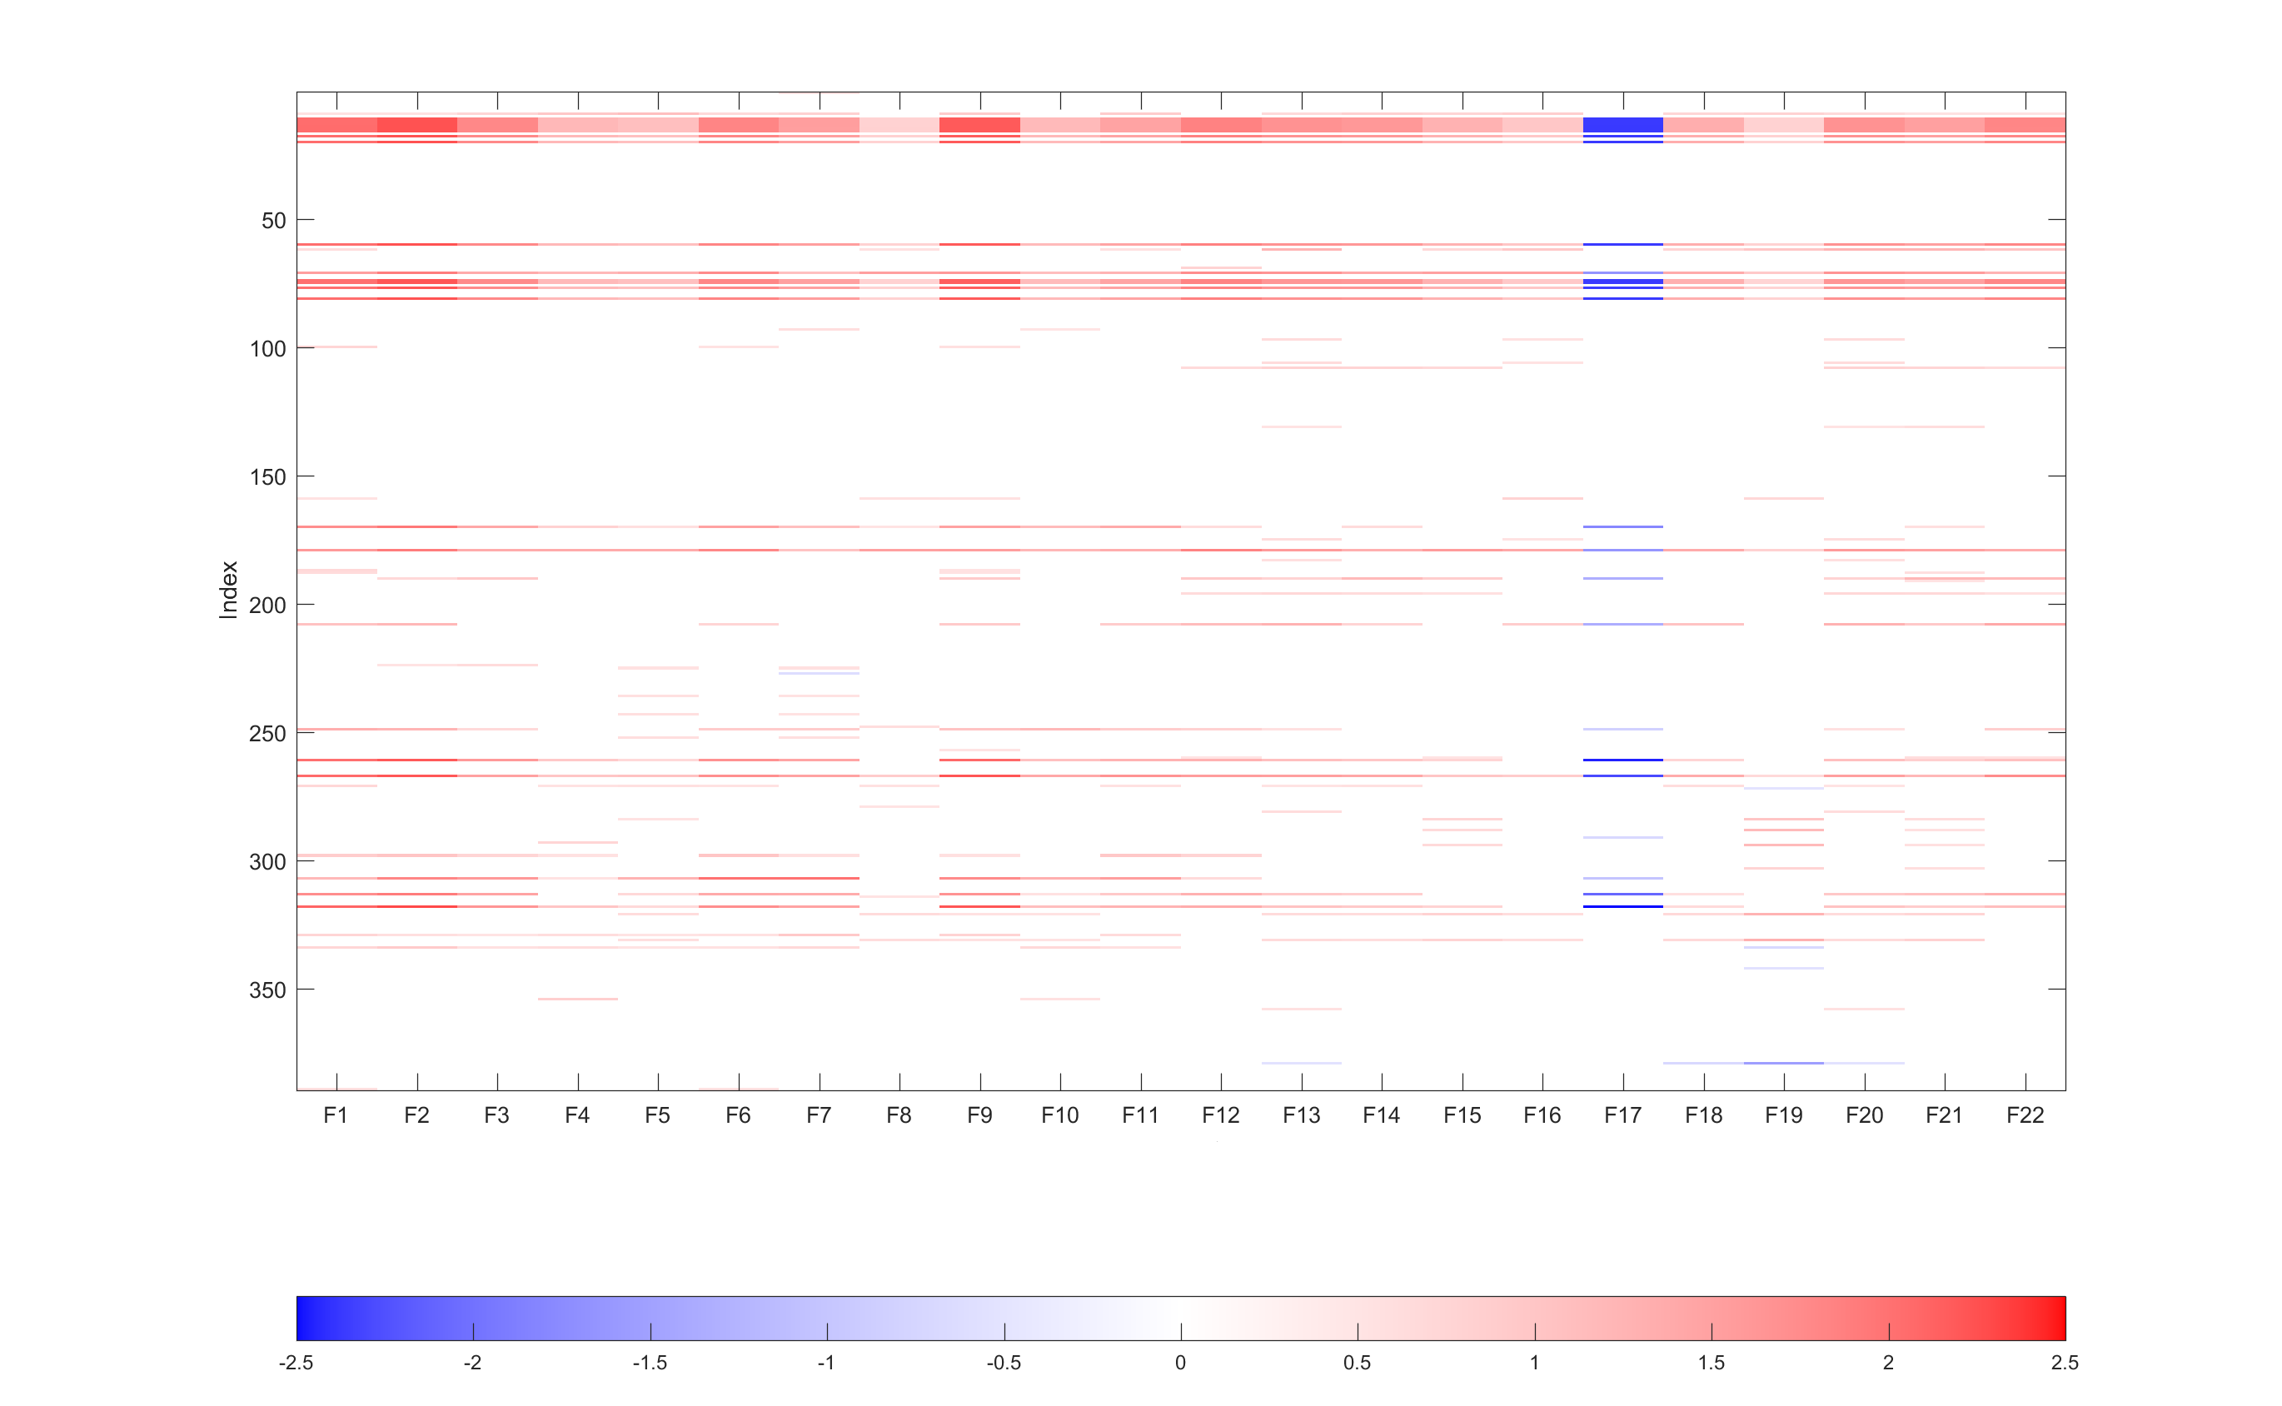



Extended in Figure 6
$$p<{10}^{−6}$$
$${10}^{−6}<p<5×{10}^{−6}$$
$$p>5×{10}^{−6}$$
Cocaine
Opioid

Slide 2
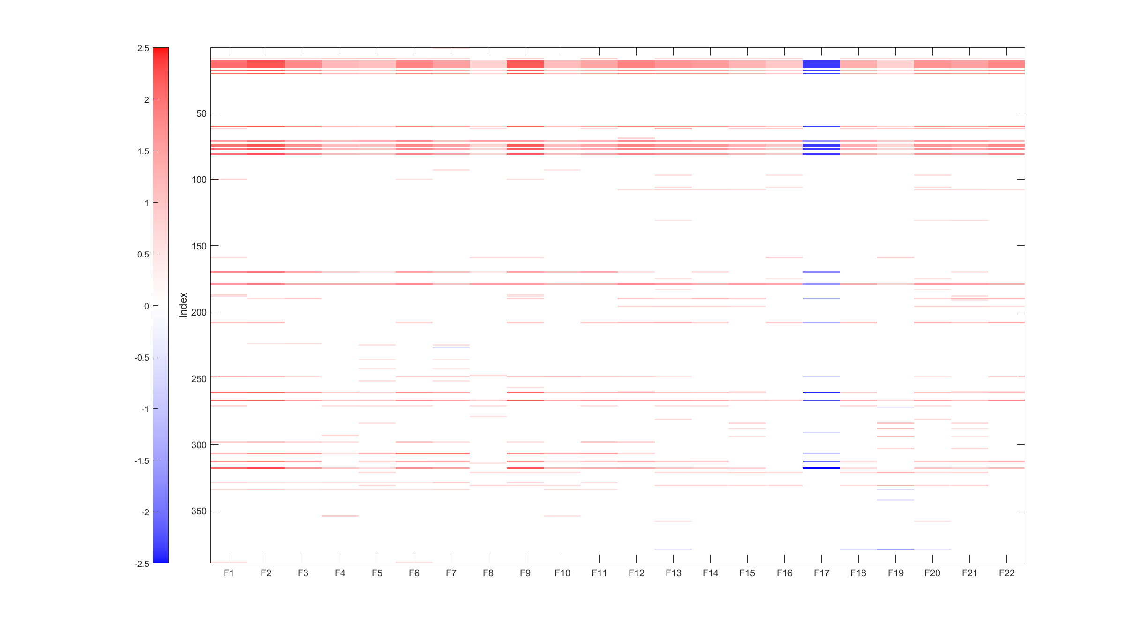
Extended in Figure 6
$$p<{10}^{−6}$$
$${10}^{−6}<p<5×{10}^{−6}$$
$$p>5×{10}^{−6}$$
Cocaine
Opioid

Slide 3
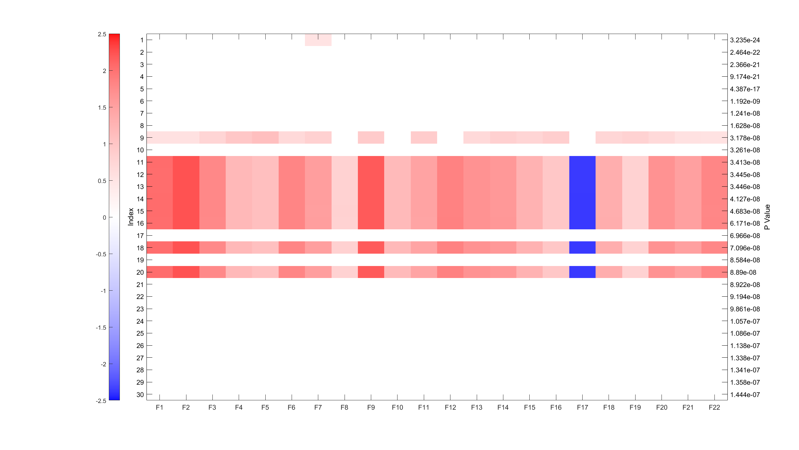
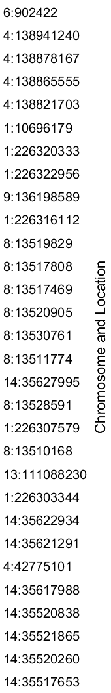
Cocaine
Opioid

